Slide 1
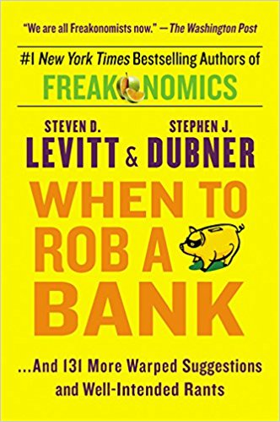
Which Banks To Rob?
Inspired by
When to Rob a Bank
Stephen D. Levitt & Stephen J. Dubner

Slide 2
FBI Interesting Statistics 2016
4251 robberies in 2016.
Friday is the day with the most frequent robberies, Sat and Sun the least.
3 Average number of successful bank heists before a robber is caught
22% of U.S. bank robberies where the cash was recovered (2010)
177 guards on duty during robbery.
8 robbers injured (0.002%) out of 4251 robberies.
Most robberies: Texas (301), New York(371), California (462)

Slide 3
Project
Identify vulnerable banks based on $ deposits, distance from police stations, armed civilians, bank ratings, number of officers, and crime rates.
https://github.com/hhalim/TargetBanks/
https://github.com/hhalim/TargetBanksJupyter

Slide 4
Data Gathering
FBI Crime Data
https://ucr.fbi.gov/crime-in-the-u.s./2016
FBI Police Employment Numbers
https://ucr.fbi.gov/crime-in-the-u.s/2016/crime-in-the-u.s.-2016/tables/table-26/table-26.xls/view
Federal Firearms License Holders
https://www.atf.gov/resource-center/data-statistics

Slide 5
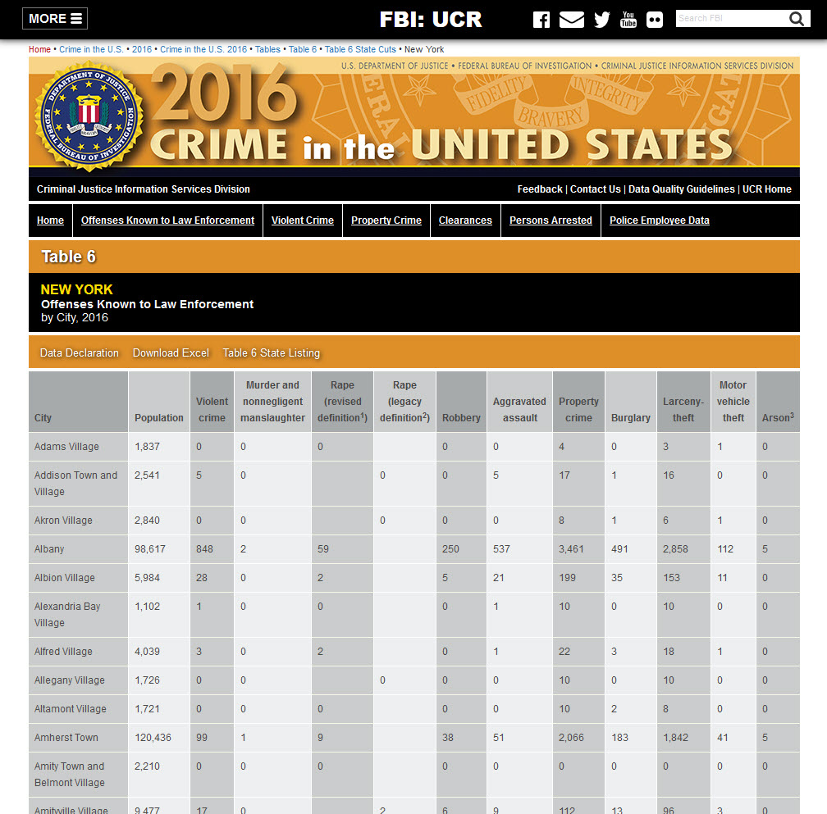
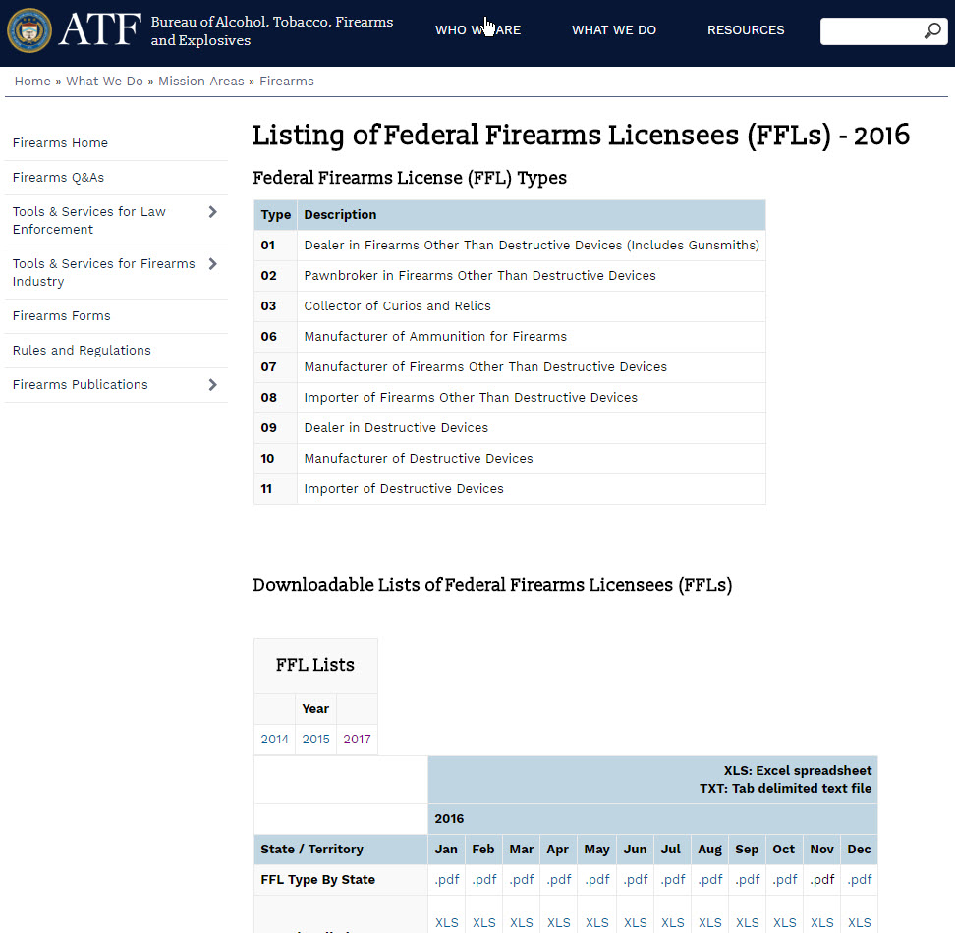

Slide 6
Data Gathering
Web scraping / API:
Federal Deposit Insurance Corporations http://www5.fdic.gov
Policeone.com http://www.policeone.com/law-enforcement-directory/
Google Map API for latitude and longitude.
Google Place API for ratings.

Slide 7
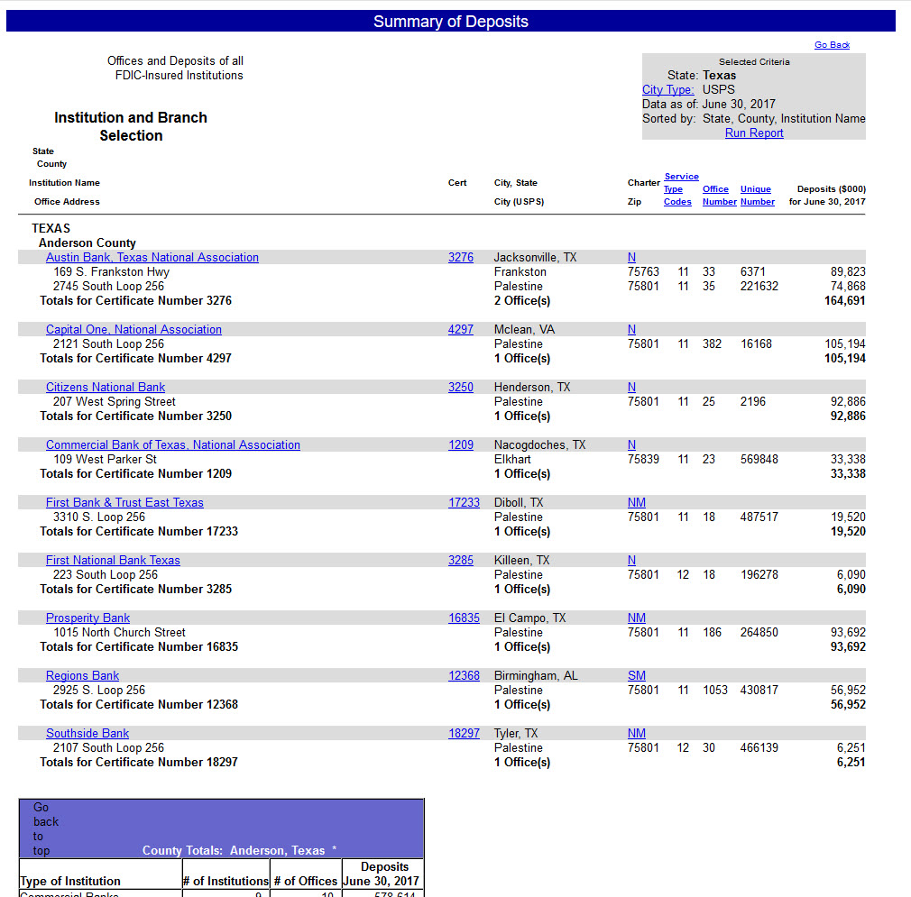
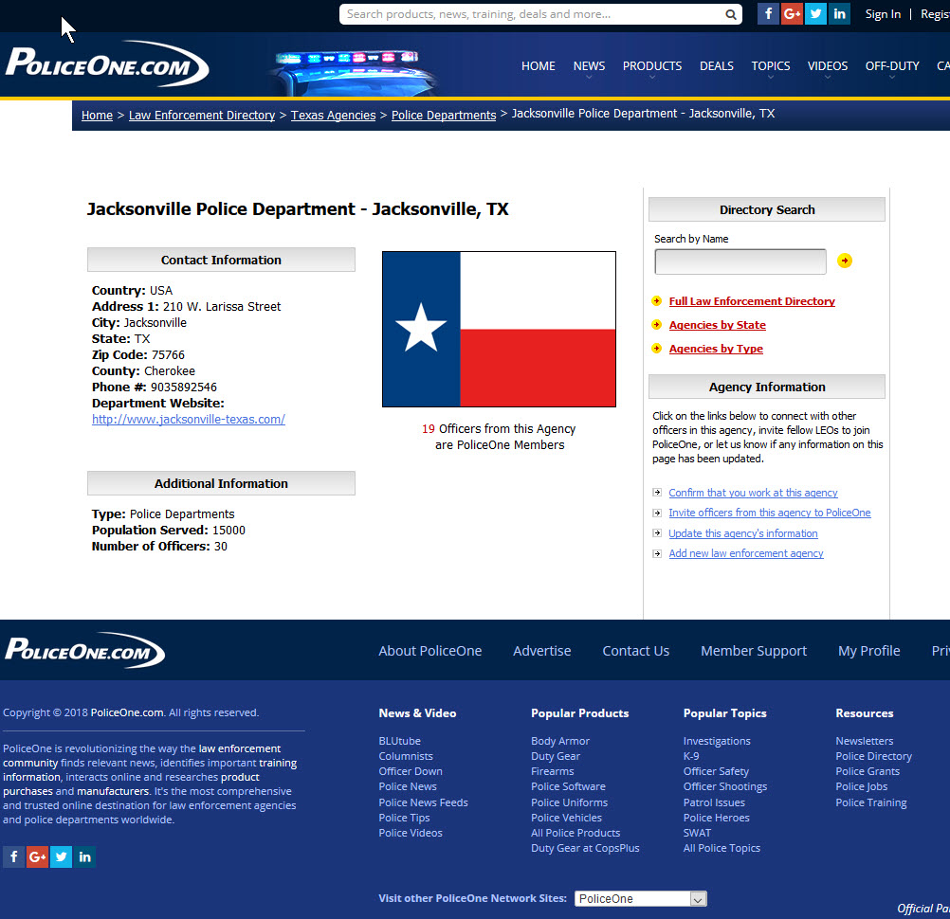

Slide 8
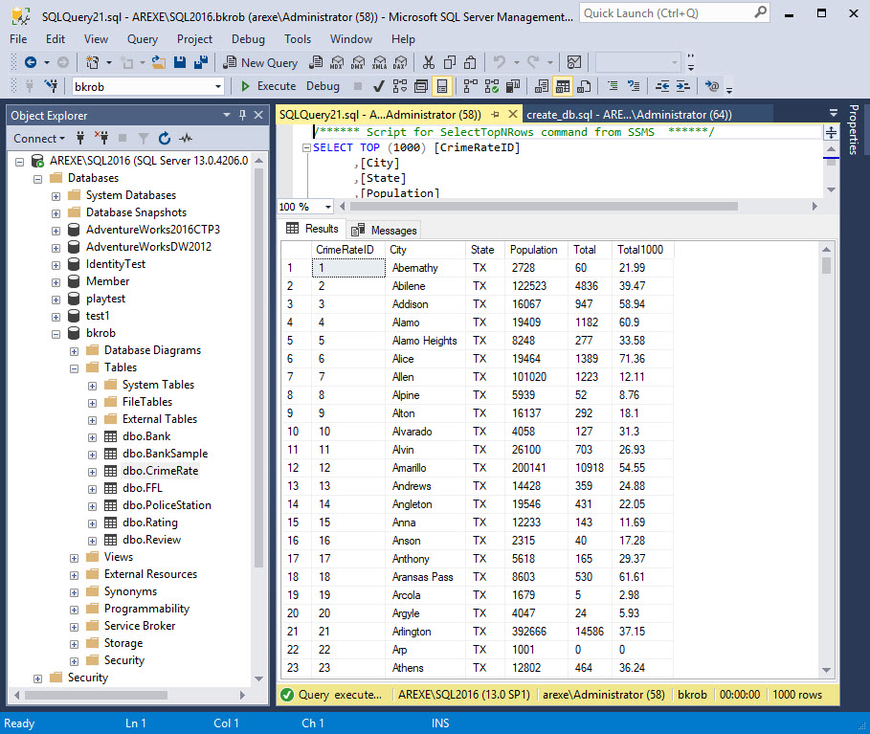

Slide 9
Data Cleaning, Imputation, Features
Removed duplicates, filled in some missing data or wrong addresses.
Latitude and longitude data using Google map API.
Features:
Number of closest Police Stations within 10 miles for each bank.
Closest distance to the Police Station for each bank.
Number of FFL within 5 miles for each bank.
Officers number per 1000 population.
Possible $ take for each bank (0.05% of FDIC deposit)
Probability of getting caught by closest distance to Police Stations
y = 70 – 10x

Slide 10
Supervised Learning Model
Created sample 10% data from all the banks data (sample.sql).
From this sample, use algorithm to decide whether a bank is a vulnerable target or not (target.py).
Classify 1 – 5 based on multiple conditions and $ take/reward.
Some sample formulas:
Police response: pPoliceResp = -0.1 + (0.4 * officersRate)
Civ. Armed response: pArmed = -0.004444 + (0.0206 * fflCount)
Ratings: pRating = 0 + (0.1 * avgRating)
Probability of Success:
1 - (((pDistance * 0.75) + (pPoliceResp * 0.25)) * 0.65) - (pArmed * 0.20) - (pRating * 0.15)

Slide 11
Train Machine Learning Models
Unsupervised Model: K-Means modeling KMeans_TX.ipynb
Supervised Model: modeling.ipynb

